Slide 1
Metabolic Roles of Uncultivated
Bacterioplankton Lineages in the
Northern Gulf of Mexico “Dead Zone”
Thrash et. al. 2017
Duplicating the results
Patrick Hennig - 2021-05-28

Slide 2
Sequencing Data
Biological samples from 2 sites
Illumina paired end reads
  One run per site for DNA
  One run per site for mRNA
Equal to 25% of the paper’s reads

Slide 3
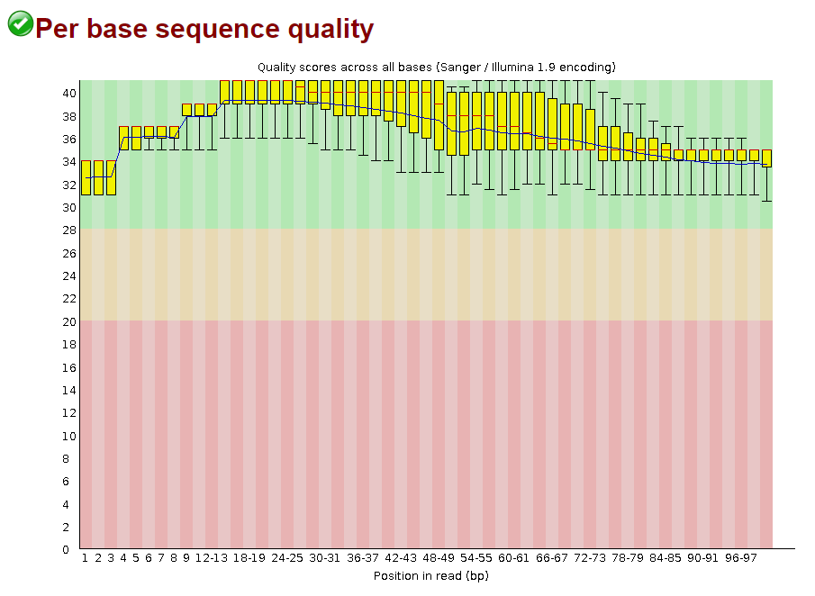
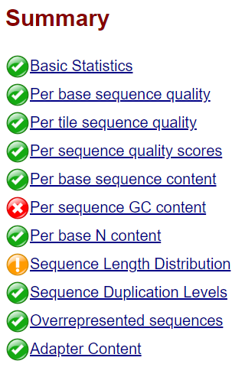
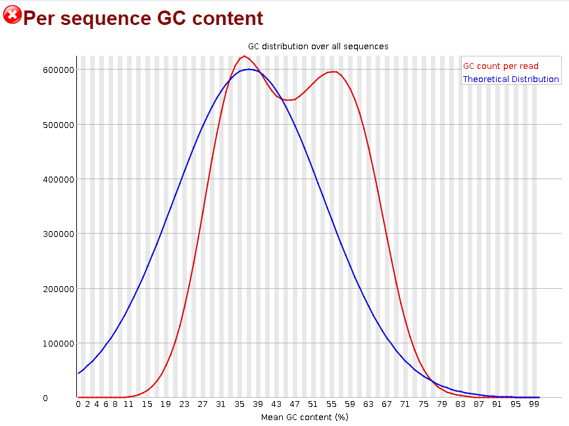
Read Quality check with FastQC - DNA

Slide 4
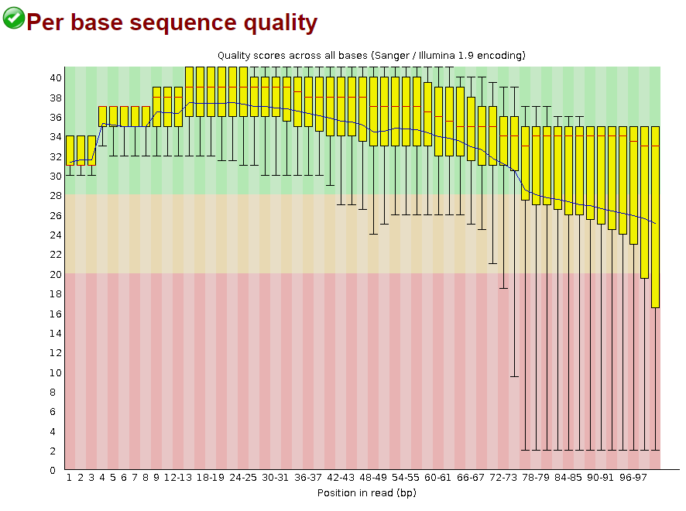
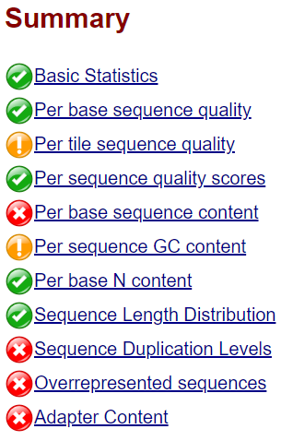
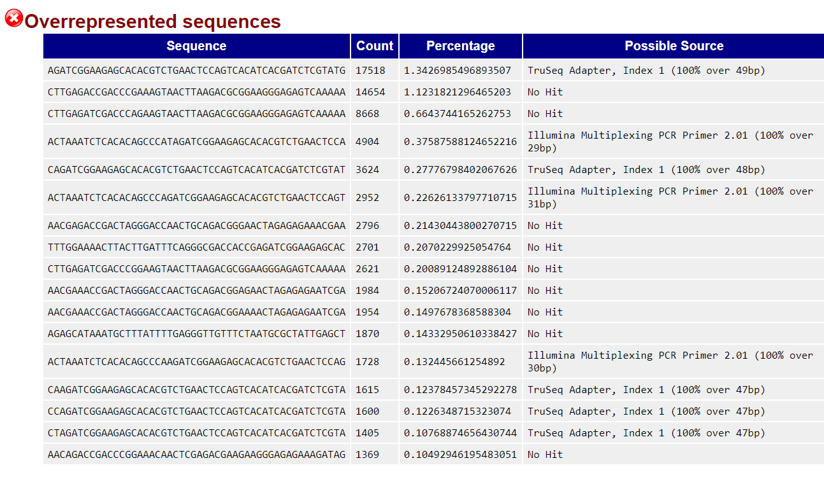
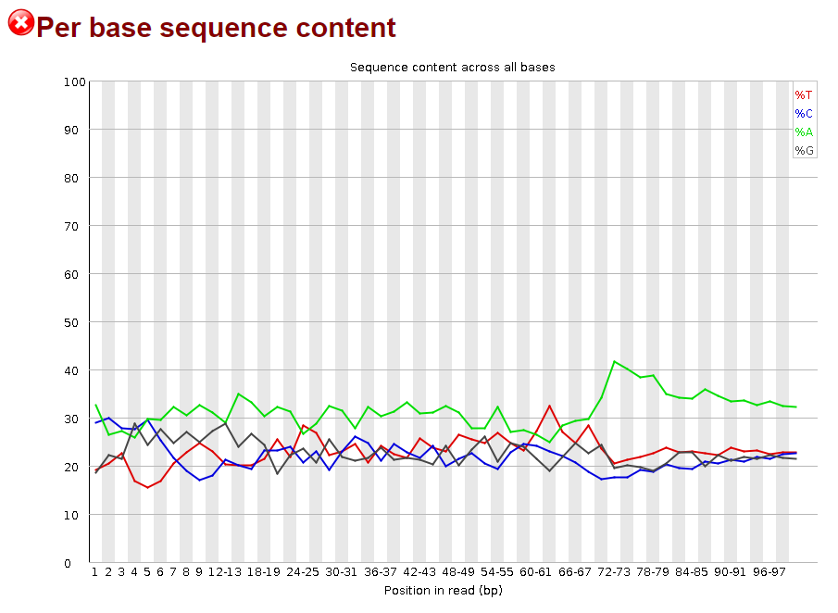
Read Quality check with FastQC - mRNA

Slide 5
Read Quality check
FastQC
DNA
mRNA

Slide 6
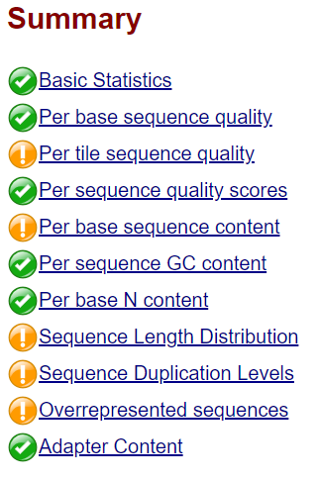
Trimming - mRNA
Leading/Trailing low quality sequences
Adapter sequences
Sliding window
Trimmomatic
FastQC

Slide 7
Metagenome assembly and QC
Megahit assembler
231Mbp total genome length
  Paper: 217Mbp
N50 980
346472 contigs
Quast QC

Slide 8
DNA binning
Metabat
Tetranucleotide freqencies + coverage
26 bins estimated
Not all contigs used

Slide 9
DNA binning QC
CheckM
Marker genes → estimate completeness, contamination
Rough taxonomic ID assignment

Slide 10
DNA binning QC
Continue with bins:
  >10% completeness and
  <10% contamination
17/26 bins left
Rough taxonomic assignment:
  Mostly Kingdom only

Slide 11
Functional annotation
Annotation using Prokka
Different algorithms for e.g.:
  Genes
  CDS
ca. 28k genes & CDS across metagenome
Paper: 140k genes

Slide 12
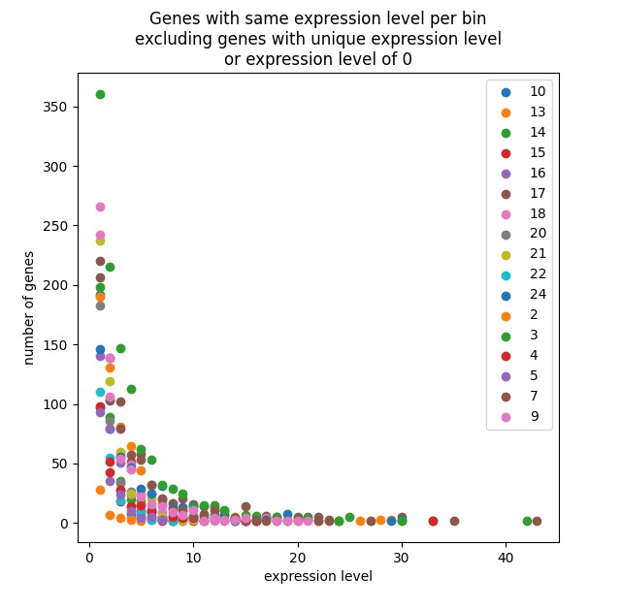
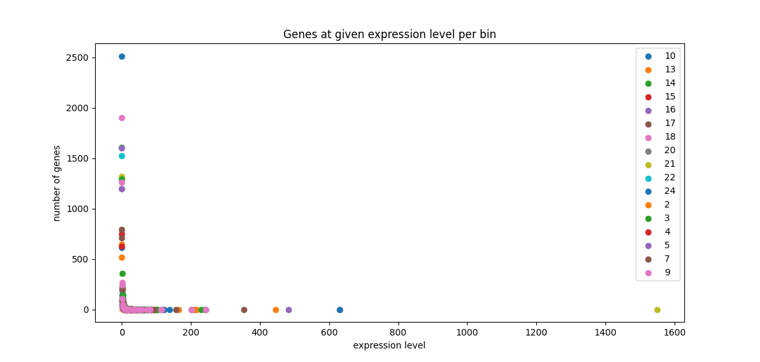
Analysis of bin activity
Mapping using bwa
Mapped reads counted using htseq

